Slide 1
Mushtaq Raza
MAP-i Doctoral
Student, 2011-2012

Slide 2
Agenda
Title
Abstract
Reification vs. Reverse Specification
Code Slicing
Word count Example
Removing the accumulation parameters
Introduction of mutual recursion
Conclusion

Slide 3
Title
Reverse Program Calculation Supported by Code Slicing

Slide 4
Abstract
Reverse Engineering combines formal methods and semi-formal methods.
Reconstruct the formal specification of legacy code
Algebra of programming is applied in reverse order.
Code slicing is used for trimming down the complexity.

Slide 5
Abstract Contd.
Reverse calculation is achieved through imploding auxiliary variables.
Introducing mutual recursion
transforming semantic function into generic programming schemata

Slide 6
Literature Review
Source code is translated into an intermediate language, from which equational descriptions of the functionality is calculated. Ref.[11] of the paper.
Reconstruction of specifications from legacy code on pre-/post-condition. Ref.[4,7,8,9] of the paper.
Source code is reconstructed until a recursive version is reached, upon which properties of program can be deduced. Ref.[25] of the paper.

Slide 7
Reification vs. Reverse Specification
Specification to implementation (one to many)
Software reification (refinement) is the process of converting abstract software specifications into real application. (Forward Engineering)
Higher level abstraction from implementation
Identifying component and behavior of a system in order to create higher level abstraction (Reverse Engineering)

Slide 8
Code Slicing “A semantically sound code-decomposition technique”
Formal description of large piece of code can be overwhelmingly complex and counterproductive to inspect.
Slicing is the syntactic separation of program in its constituent slices.
Find the slices semantics and “re-constitute” the whole program semantics

Slide 9
Example- Word Count Program
Simplified version of the Unix wc command which print the no. of bytes, words and lines
HASKELL Programming Language is adopted to express the functional semantics of slice of piece of code
NL: New Line
NC: New Character
NW: New word

Slide 10
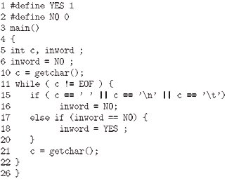
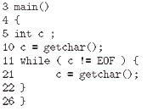
Slicing of the Example code
Gallagher and Lyle identify the following slice decomposition lattice for this program
Clearly there are three maximal slices to be extracted given in the snapshot. Slice S(c) and S(inword) are auxiliary slices
“C “ and “inword” are not an output variables, so these slices will not become apparent in the specification. “C” role is to unveil the underlying inductive type upon which the whole program is structured and “inword” support the computation of nw
The Bottom Slice
Slice S(inword)

Slide 11
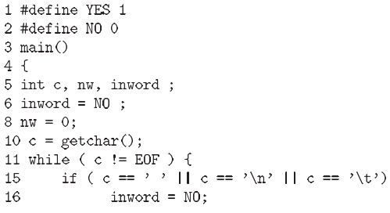
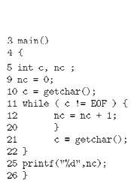
Slicing of the Example code(Contd)
For semantic extraction the study proceed three slices S(nc), S(nl), S(nw). Study also concluded the semantics for these slices in HASKELL which is given on the next slide
Semantics for S(nw)
Semantics for S(nc)
Semantics for S(nl)

Slide 12
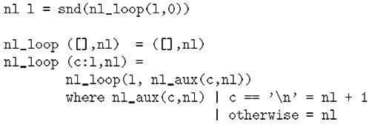
HASKELL’s Semantics for given Slices
Slice(nc)
Slice(nw)
Slice(nl)

Slide 13
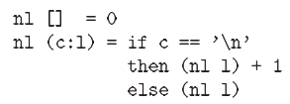
Removing the accumulation parameters
Now remove the accumulators that is, the non-inductive parameters of nc, nl, nw
Concerning nc, study obtained
where succ n=n+1 this can be recognized as
HASKELL’s length function i.e
nl which is identified as
list cata-morphism
Exercise 3.45 in [3] of the
paper.

Slide 14
Introduction of mutual recursion
The reverse specification is not yet sufficiently abstracted
Final calculation will remove inward (auxiliary) parameter
After applying mutual recursion law (22) in the paper
Variable inward disappeared through out this calculation.

Slide 15
Summary
Combined formal with semi-formal to perform reverse specification.
Its constructive approach based on the powerful algebraic laws
Trimming down the complexity of handling all program variables at the same time through slicing.
Imploding auxiliary variables and introducing mutual recursion.
Finally the three slices are independent of each other a result know as banana-split law see (22) of the paper

Slide 16
Evaluation of the paper!!!
+
Abstract is clear and concise, having clear topic, hypothesis, method and results.
Overall paper is written in understandable language.
-
Final sentence of the introduction doesn't describes the
purpose of the study.
Used “we” instead of study or paper.
Introduction is the repetition of abstract.
Written in very abstract way no enough explanation.

Slide 17
Questions and Answers

