Slide 1
Transforming Data by Calculation
Author: Professor J.N. Oliveira
Presentation by: Mohammadreza Vali zadeh

Slide 2
outline
Why data transformation?
Introducing the Point-free Transform
Data Structures transformation
Data Impedance Mismatch
conclusion

Slide 3
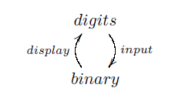
Why data transformation?
Watch a calculator

Slide 4
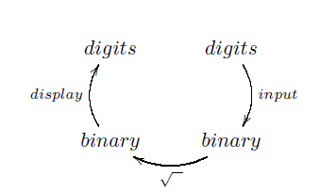
…
square root
Inside a machine these processes happen very much

Slide 5
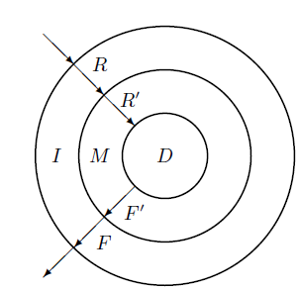
…
Such processes happen very much in software systems too.
Each layers stay in different programming paradigms (object-oriented database, relational database)

Slide 6
…
Data transformation: Middle-ware code to bridge the gap between two different technology layers
Main motivation for data calculation is the need for data mapping

Slide 7
…
Different data models can be compared via abstraction and representation
Three kinds of fault solution
Loss of data
Confusion among data Data representation
Wrong computation Data processing
Helping in preventing any of these from happening in software designs is the main aim of this paper

Slide 8
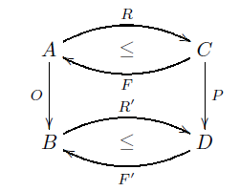
Introducing the Point-free Transform
Converting predicate logic formula into binary relations by removing variables and quantifier(Algebra of programming)
The main principle of the PF-transform:
“everything is a binary relation”
A R B
Notes:
H

Slide 9
Data Structures transformation
Data structure: Varity notation , programming language and paradigm

Slide 10
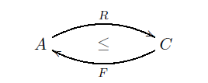
…
Mapping scenario (transformation)
Type-level mapping of a source data model to a target data model
Two maps (map forward & map backward) between source & target data

Slide 11
…
The transcription level mapping of source operation to target operation

Slide 12
…
Sample: Datatype
In haskell:
In c:

Slide 13
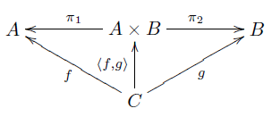
…
In haskell:

Slide 14
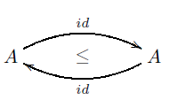
Data Impedance Mismatch
Different data models can be compared via abstraction or representation (in transformation)
It has complexity
The least impedance mismatch is between a data type and itself

Slide 15
conclusion
Mathematical approach to data transformation is presented
Converting data models to each other
Try to solve the impedance problem
Consequence: finding problems in system
Future: Apply transform in practice and Laplace

Slide 16
Thank you for your attention

