Slide 1
‘Galculator’
Functional Prototype of a Galois-connection Based Proof Assistant
João Carneiro 22/06/2012
Thematic Seminar – MAP-i

Slide 2
Outline
Introduction
Contextualization
Galculator
Related Work
Conclusions

Slide 3
Introduction
Software correctness
  Ambitious challenge
  Augment confidence in programs written
  Eg. Formal and Informal techniques
  The success of each of these methods varies greatly but there seems to be evidence that success is proportional to tool support (Jackson, 2006).
Logic based approaches
  Advantages
    Benefit from the help of theorem provers in the conduction of proofs
    Using annotations and tools, programs can be verified and formal proof obligations be discharged
  Disadvantages
    There are theoretical limits imposed by the undecidability of general predicate calculus

Slide 4

Introduction
Haskell function:
This function computed whole division, for non-negative x and positive y
To prove the correctness (we can use a standard proof: eg. Structural induction, fixpoint induction)
BUT
What we have above is code – Where is the specification?
In literature we can find at least two definitions: one implicit

Slide 5
Introduction
and the other explicit
The following Galois connection (Ore 1944) arises from the last definition:
And another important Galois connection is (cancellation):
Which explains subtraction over the integers (another operator used in the algorithm)
Notes:
Correctness verification assumes that both specification and implementation are available before proofs take place. A different, more constructive alternative would be to calculate the implementation from the specification itself.

Slide 6
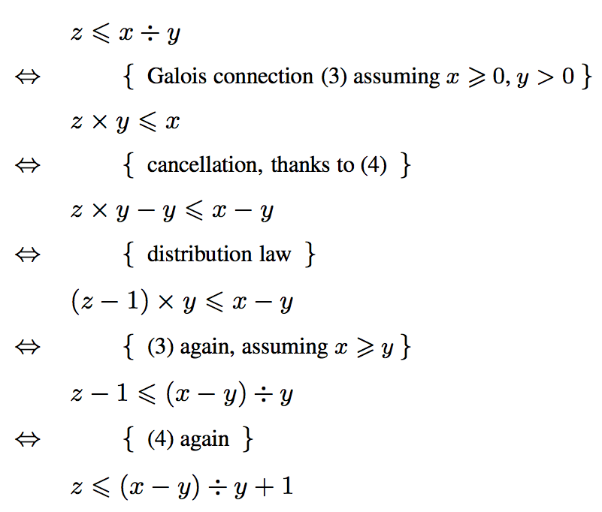
Introduction
We can put these two connections together by restricting (3) to non-negative integers, keeping y ≠ 0. We reason:

Slide 7
Introduction
We conclude that the two expressions are the same:
This simple (non inductive) proof shows the calculational power of Galois connections operated via indirect equality, which are applicable to arbitrarily complex problem domains.
Galculator does not intend to be a classical theorem prover (TP) because it is not usable in arbitrary proofs: only in those where adjoint operators of Galois connections participate. However, it can be very useful when used together with a “host” TP such as e.g. Coq (Bertot and Casté́ran 2004).
Notes:
WE CONCLUDE THAT THE 2 EXPRESSIONS ARE THE SAME

Slide 8
Contextualization
One of the keys to functional programming is the ability to compose functions to create new functions.
Haskell
  Used to implement the Galculator prototype
  Purely functional programming language
  Statically typed (types are checked at compile-time)
  Lazy evaluation
  Polymorphic (parametric and ad hoc polymorphism)
  Allows Shorter, clearer, and more maintainable code
Notes:
In functional programming, programs are executed by evaluating expressions, in contrast with imperative programming where programs are composed of statements which change global state when executed.
Lazy evaluation - expressions are not evaluated when they are bound to variables, but their evaluation is deferred until their results are needed by other computations.

Slide 9
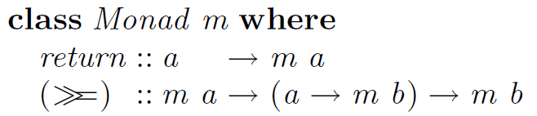
Contextualization
Haskell Monad
  Structure that represents computations
  Consists of a type constructor m and two operations, bind (>>=) and return
  Used to deal with computations such as:
    I/O;
    common environment or state;
    preprocessing of computations (simplification, optimization etc.)
  Available via standard type class Monad:

Slide 10
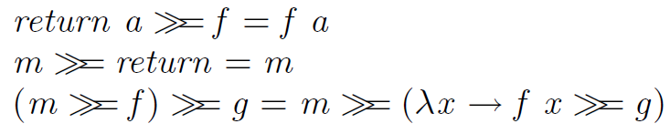

Contextualization
Haskell Monad (cont.)
  Every instance shall obey the monadic laws:
Haskell MonadPlus & MonadOr
  Used in Galculator
  Provide mzero operator for modeling failure
  MonadPlus
    Uses mplus operator, which obeys to the left-distribution law:
    Backtracking behavior, where all the possible combinations are tried

Slide 11
Contextualization
Haskell MonadPlus & MonadOr (cont.)
  MonadOr
    Defines a morelse operator which obeys the left catch law:
    The second argument is only tried if the first one fails
Galois connections
  Particular correspondence between two partially ordered sets (posets), preordered sets or classes
  Let (A, ≤) and (B, ≤) be two partially ordered sets. A Galois connection between these posets consists of two monotone functions: F : A → B and G : B → A, such that for all a in A and b in B, we have F(a) ≤ b if and only if a ≤ G(b)
Notes:
In this situation, F is called the lower adjoint of G and G is called the upper adjoint of F.
The upper/lower terminology refers to where the function application appears relative to ≤
An essential property of a Galois connection is that an upper/lower adjoint of a Galois connection uniquely determines the other.
Consequently, it's natural to use a pair of symbols to denote upper and lower adjoints

Slide 12


Contextualization
Galois connections (cont.)
Essence of the Galculator
Given two preordered sets (A, ) and (B, ) and two functions and , the pair (f, g) is a Galois connection if and only if, for all a ϵ A and b ϵ B:

Slide 13
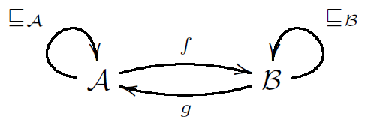
Contextualization
Galois connections (cont.)
Function f (resp. g) is referred to as the lower adjoint (resp. upper adjoint) of the connection
Represents the source domain of the lower adjoint on the left
The arrow notation emphasizes the categorical structure of Galois connections
Once a concept is identified as adjoint of a Galois connection, all generic properties are inherited, even when the other adjoint is not known
Galois connections build up on top of themselves thanks to a number of combinators which enable the construction of new connections out of existing ones
Notes:
This is the graphical notation of a galois connection

Slide 14

Contextualization
Pointfree transform
  The overall operation of the Galculator is based on transforming and rewriting terms involving adjoints of Galois connections
  Care must be taken when rewriting terms: free and bound variables make substitutions tricky
  This complexity can be overcome by transforming variable-level logical formulæ into pointfree formulæ involving binary relations only
  Once PF-transformed, formulæ involve binary relations only (R, S, etc) and relational composition (R S) becomes the main “glue” among terms:
Notes:
Notation b R a means that pair (b, a) is in R

Slide 15
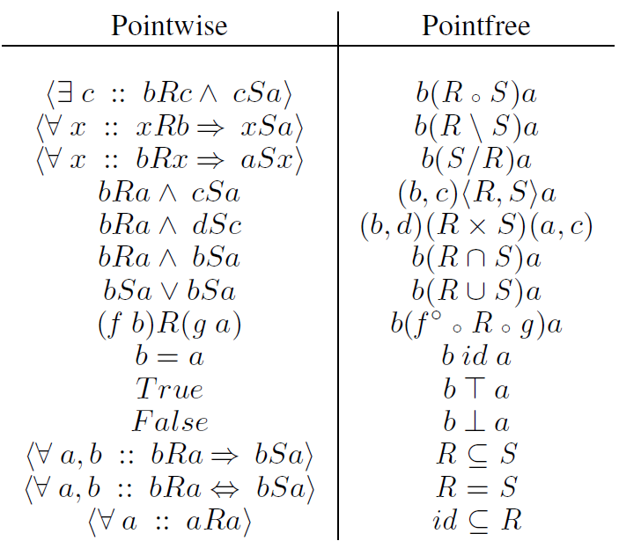
Contextualization
Notes:
Here is presented a brief overview of the pointfree transform

Slide 16
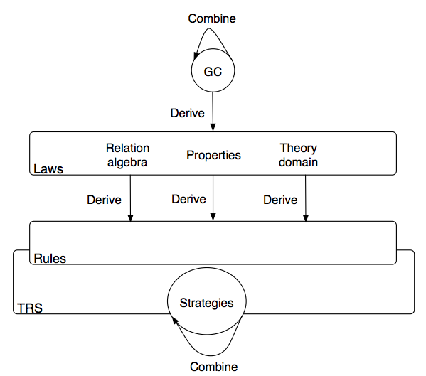
Galculator
Prototype of a proof assistant of special brand

Slide 17
Galculator

Slide 18
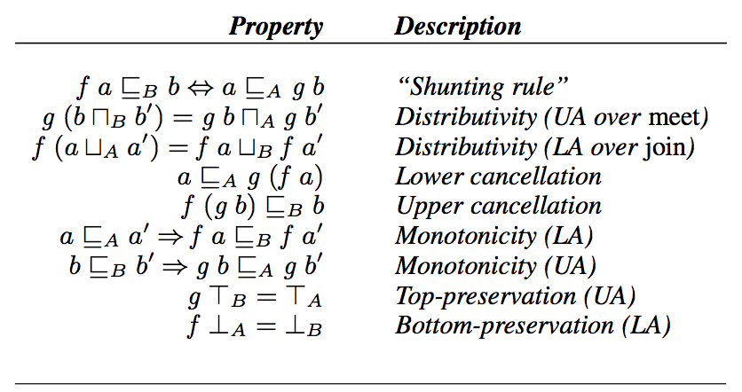
Galculator

Slide 19
Galculator

Slide 20
Galculator
Galois connection is the main block
Galculator combines the Galois connections to create new connections from the existing ones
From each Galois connection, Galculator derives its properties as given in last table
From this properties together with laws from relation algebra and algebraic properties of the particular domain of the problem being solved, form the set of laws of the system
In ordem to represent all these concepts several embedded domain specific languages were defined (DSLs)
Notes:
From each Galois connection the Galculator derives its properties as given by Table 1 which, together with laws from relation algebra (Bird and de Moor 1997) and algebraic properties of the particular domain of the problem being solved, form the set of laws of the system.

Slide 21
Galculator
Galculator proofs are transformations of the abstract representation of the equality being proved. These transformations are made according to the equalities enabled by the laws of the system
Laws are objects arising from the theoretical level; they can- not be applied to representations
A mechanism is defined for deriving functional applications of the available laws in the form of rewrite rules
The application of such rules is performed by a strategic term rewrite system (TRS)
Basic rewrite strategies can be combined in order to build more complex ones, according to the complexity of the problem

Slide 22
Galculator
Architecture
  Interpreter: The command line provides for interactive user interfacing
  Parser: Several domain specific languages (DSLs) are available in order to express the concepts in use
  Type inference: The system supports parametric polymorphism
  Term rewriting system: The core of Galculator is its term rewriting system (TRS)
  Property inference: This component derives the properties stated in last Table from the starting specification and adds them to the system

Slide 23
Related Work
Galois connections in Coq
  This work combines Galois connections and Coq (Pichardie, 2005)
  Developed in the context of work on abstract interpretation where adjoints are defined over complete lattices
  Proofs of the general properties that Galois connections enjoy are defined in order to be executed in Coq, however, Galois connection algebra is not exploited in order to combine existing connections nor is it applied to proofs
  This work in a sense complements the Galculator approach since it can discharge proof obligations about adjoints prior to loading these into the system
2LT
  2LT is aimed at schema transformation of both data and migration functions in a type safe manner
  Further developments deal with calculating data retrieving functions in the context of data schema evolution and invariant preservation through data refinement
  Galculator representation technique and the rewriting strategies implemented were mostly influenced by this system
Notes:
The core of the Galculator is inspired on the 2LT system.

Slide 24
Related Work
PF-ESC
  A tool which performs pointfree extended static checking (Necco et al. 2007)
  Uses the relation calculus to simplify PF-transformed proof obligations and Galois connections are used implicitly in the underlying calculus
  The PF-ESC representation uses properties to classify relations while the Galculator uses the type representation itself
    Advantage: the system is more flexible
    Disadvantage: predicate functions which calculate the properties of expressions are required in order to apply certain transformations. This makes the system not extensible because rewrite equations must be hard-wired into functions
Notes:
and is also inspired on 2LT,
Some concepts are similar with the ones used in the Galculator but the 2 system are different.

Slide 25
Related Work
Proof processor system
  Tool developed in Haskell
  Use the calculation approach proposed by Dijkstra and Scholten in teaching discrete maths
  Was based in the E logical calculus to exploit quational proofs written in Z notation (Spivey, 1989)
  The system helps the user by detecting errors in proofs and suggesting valid deductive steps.
  Unlike Galculator, this system does not provide type support and does not use Galois connections as a building block of the calculus implemented.

Slide 26
Conclusions
The Galculator is a proof assistant which implements an innovative approach to theorem proving, different from what is traditional in the field.
The way how Galculator was developed in Haskell was presented.
The Galculator turns in the first proof engine ever to combine and calculate directly with PF-transformed Galois connections.
The prototype proposed is a non-trivial illustration of the power of functional programming advanced features or building prototypes of complex systems.
This prototype uses an own rewriting system instead of using another rewriting engine.

Slide 27
Questions?

