Slide 2
Plan
Introduction
What is a Program Fault?
Deterministic/Non-Deterministic Programs
A Refinement Calculus
Relative Correctness for Non Deterministic Programs
Background
Definitions
Properties
Relative Correctness and Refinement
Relative Correctness and Refinement Lattice
Concluding Remarks

Slide 3
What is a Program Fault?
In Ramics 2014, Mili et al.
Introduce the concept of relative correctness:
The property of a program to be more-correct than another one with respect to a given specification.
Use relative correctness to define the concept of a fault in a program:
A program fault is any feature that admits a substitution that would make the resulting program strictly more-correct.
(e.g. a statement, condition, block of statements, set of non-contiguous statements)

Slide 4
What is a Program Fault?
Among the multiple ramifications of relative correctness:
Traditionally, candidate programs are divided into two broad classes
correct programs and incorrect programs.
With relative correctness, we have a rich structure of partial ordering.
Traditionally, verification and testing have a clear cut division of labor:
Verification methods are used to prove the correctness of correct programs.
Testing methods are used to expose the presence of faults in incorrect programs.
With relative correctness, methods can be used across this dividing line;
in particular, we can apply static analytical methods to prove that a program, while incorrect, is still more-correct than another (e.g. a previous version).

Slide 5
Deterministic /Non Deterministic Programs
In Ramics 2014: relative correctness defined for deterministic programs.
Several reasons why we want to extend it to non-deterministic programs:
Reason about relative correctness of designs, partially defined programs, programs that depend on random external events, etc.
Reason about relative correctness of deterministic programs without having to capture their behavior in all its details.

Slide 6
A Refinement Calculus

Slide 7
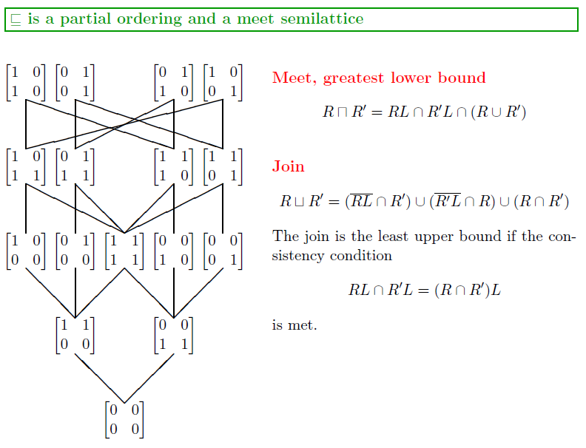
A Refinement Calculus
Notes:
Join operator, lup defined if consistency condition

Slide 8
Relative Correctness
Deterministic Programs:
Specification R,
Programs P, P’.
Competence domain of a program P: $CD=\left(R∩P\right)L.$
Interpretation: competence of program P wrt specification R is the set of initial states for which program P obeys specification R.
Relative correctness: Program P is more-correct than program P’ with respect to specification R if and only if it has a larger (than or equal) competence domain.
Relative correctness: reflexive and transitive, but not antisymmetric.
Strict relative correctness: Strictly larger competence domain.
Strict relative correctness: Transitive and asymmetric.

Slide 9
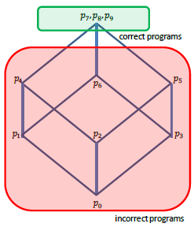
Relative Correctness
Illustration
Space S: natural numbers.
Specification, R: $R=\left\{\left(x,x^{′}\right)\right|x^{2}≤x′≤x^{3}\}$
Candidate Programs:
p0: {abort}; ${CD}_{0}=∅.$
p1: {x=0;}; ${CD}_{1}=\{0\}.$
p2: {x=1;}; ${CD}_{2}=\{1\}.$
p3: {x=2*x^3-8} ; ${CD}_{3}=\{2\}.$
p4: {skip}; ${CD}_{4}=\{0,1\}.$
p5: {x=2*x^3-3*x^2+2} ; ${CD}_{5}=\{1,2\}.$
p6: {x=x^4-5*x}; ${CD}_{6}=\{0,2\}.$
p7: {x=x^2}; ${CD}_{7}=S.$
p8: {x=x^3} ; ${CD}_{8}=S.$
p9: {x=(x^2+x^3)/2} ;${CD}_{9}=S.$

Slide 10
Relative Correctness
Interesting Properties of Relative Correctness for Deterministic Programs:
Relative correctness culminates in absolute correctness (a correct program is more-correct than any candidate program).
Relative correctness logically implies (and thankfully is not implied by) enhanced reliability (more-correct is not another name for more-reliable).
Most interestingly: P’ refines P if and only if P’ is more-correct than P with respect to any specification R.
We are interested to explore which of these properties persist when we migrate to relative correctness of non-deterministic programs.
Notes:
More reliable - stochastic

Slide 11
Relative Correctness

Slide 12
Relative Correctness

Slide 13
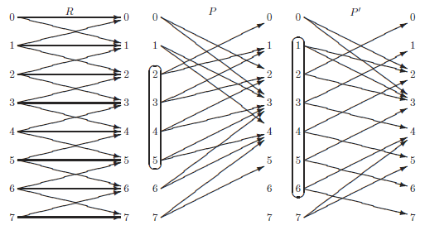
Relative Correctness
Another possible illustration:

Slide 14
Relative Correctness
Hence the definition we give for non-deterministic programs does indeed generalize the definition we had for deterministic programs.

Slide 15
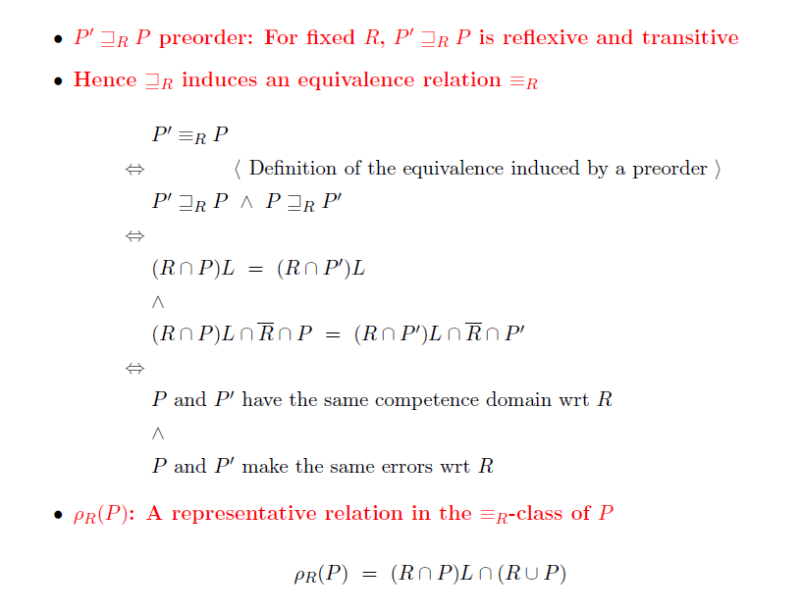
Relative Correctness

Slide 16
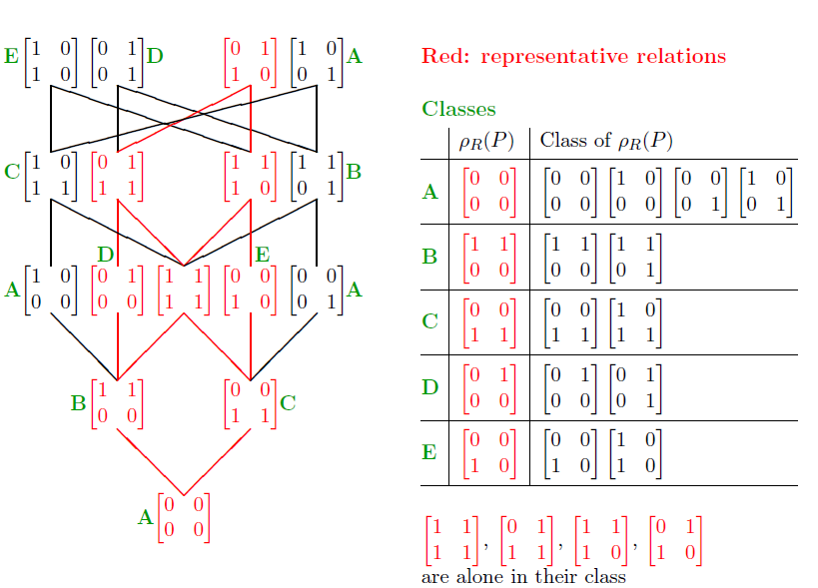
Relative Correctness
R=$\left[\begin{matrix}0 & 1 \\ 1 & 0\end{matrix}\right]$

Slide 17
Relative Correctness
R=$\left[\begin{matrix}0 & 1 \\ 1 & 0\end{matrix}\right]$

Slide 18
Relative Correctness and Refinement
Relative correctness is equivalent to refinement between equivalence class representatives:
Relative Correctness culminates in absolute correctness, i.e. a correct program is more-correct than any candidate.

Slide 19
Relative Correctness and Refinement
For deterministic programs,
we had found that P’ refines P if and only if P’ is more-correct than P with respect to any specification.
For non-deterministic programs…
Intuitive: If P’ beats P at its own game… then P’ refines P.
Question: If P’ is more-correct than P with respect to R and R refines Q, can we infer that P’ is more-correct than P with respect to Q?
Answer: No.
Counter-intuitive.

Slide 20
Relative Correctness and Refinement Lattice
The refinement ordering has lattice-like properties, where
The greatest lower bound exists for any two specifications, and it represents what the two specifications have in common.
The least upper bound exists only if the specifications R and R’ satisfy : $RL∩R^{′}L=\left(R∩R^{′}\right)L.$
In that case, the least upper bound is given by:
$$R∩\overline{R^{′}L}∪R′∩\overline{RL}∪(R∩R′)$$
which represents the addition of specifications R and R’ (i.e. the specification that subsumes R and R’ and nothing more).
Of interest: complex specifications are naturally structured by the least upper bound operator.
This raises the question:
if a specification is structured by the join operator ($Q=join(R,R^{′})$), can we prove relative correctness with respect to Q by proving it separately with respect to R and R’?

Slide 21
Relative Correctness and Refinement Lattice
The answer is nuanced…
For the greatest lower bound, it is straightforward
For the least upper bound, things are more complicated
Two complications: P’ has to be deterministic; and it is more correct with
regardless of whether this represents the least upper bound or not.

Slide 22
Concluding Remarks
Summary
Redefined relative correctness for non-deterministic programs.
Revisited its properties.
Explored how proofs of relative correctness can be decomposed along lattice operators.
Related Work
Many authors (e.g. Microsoft Research) allude to a concept of relative correctness.
They usually define it as having more correct traces, fewer incorrect traces, where correctness is judged by means of executable assertions.
Reminiscent of, but different from, our approach where relative correctness means having a larger competence domain, and violating the specification less often.
Prospects
Applications in Software Engineering (ICSE 2015).
Means to check for relative correctness by verification, testing.

