Slide 1
A Quest for Kleene Algebra in 2 Dimensions
Gheorghe Stefanescu
University of Bucharest
RAMiCS 2015
Braga, Portugal, September 28-th, 2015

Slide 2
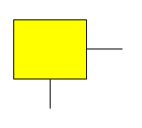
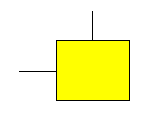
Sequential vs. parallel computation
Sequential computation … based on
FA - finite automata
Parallel, distributed, interactive computation … based on 2-dim FA, called here
SATS – self-assembling tiling systems
Natural fork and join

Slide 3
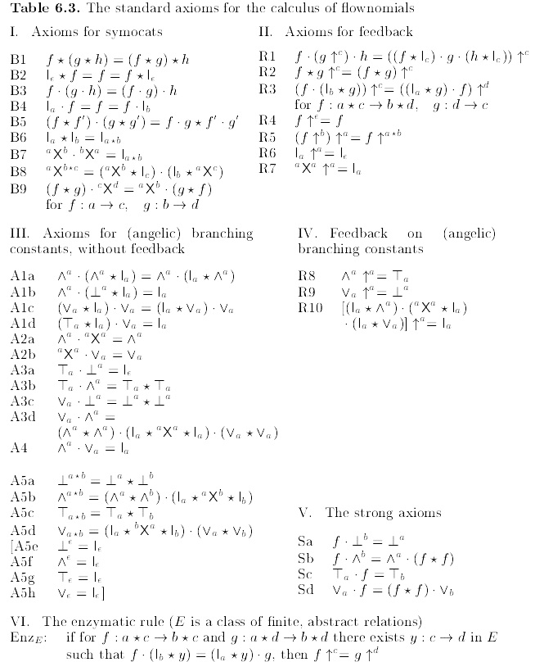
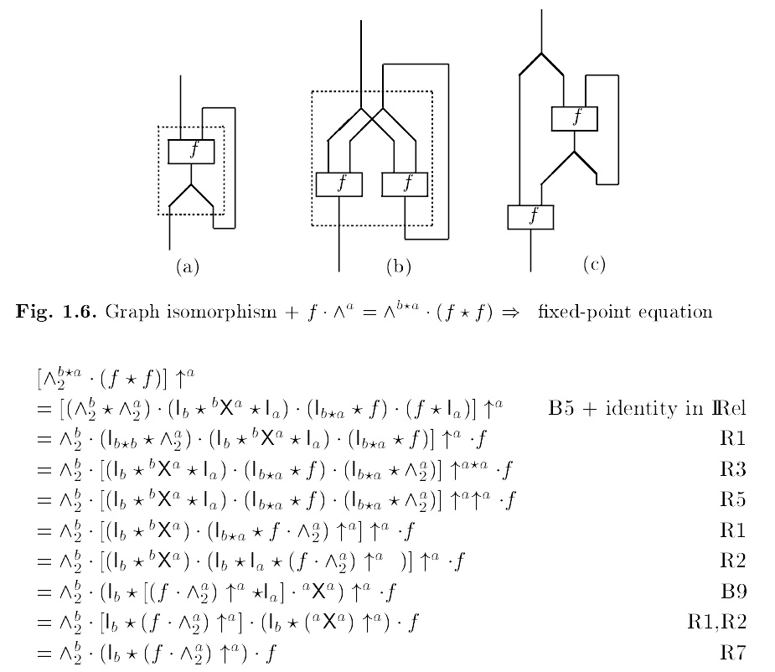
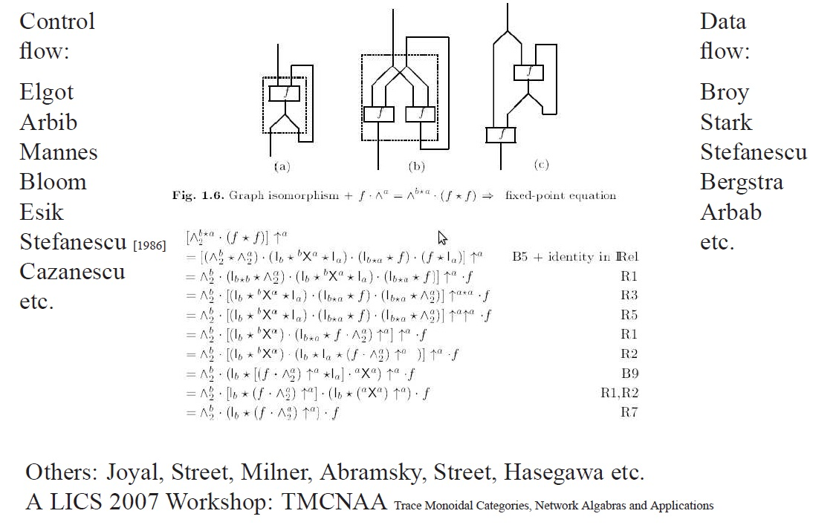
Control-flow/Data-flow networks
Mixed
control-flow + dataflow
model??
3

Slide 4
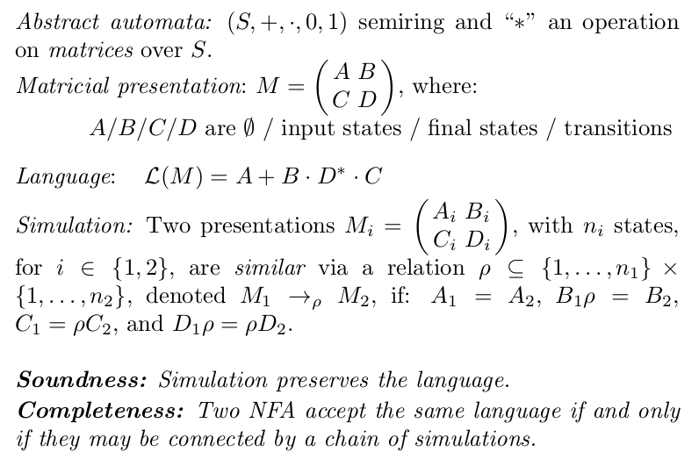
Kleene algebra – 1
Automata

Slide 5
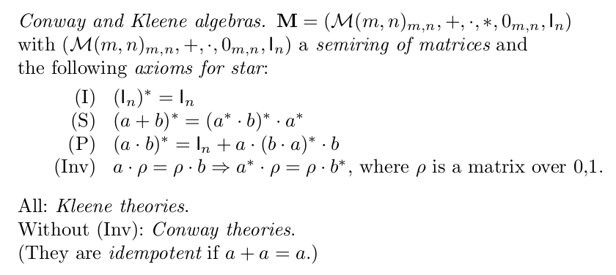
Kleene algebra - 2
Algebraic formalization:

Slide 6
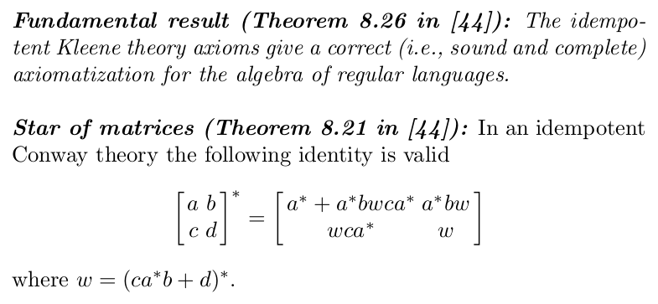
Kleene algebra - 3
Fundamental results

Slide 7
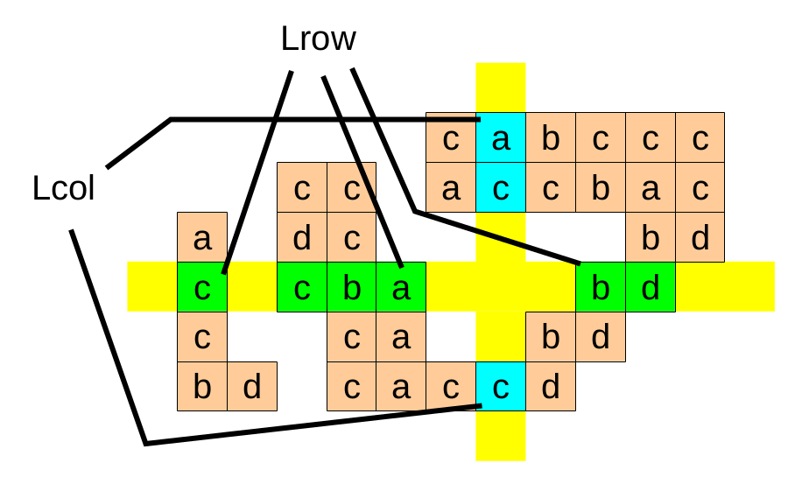
LPP – a language product problem
LPP:
Lrow x Lcol: find all 2-dim words such that
each maximal row sequence is in Lrow
each maximal column sequence is in Lcol

Slide 8
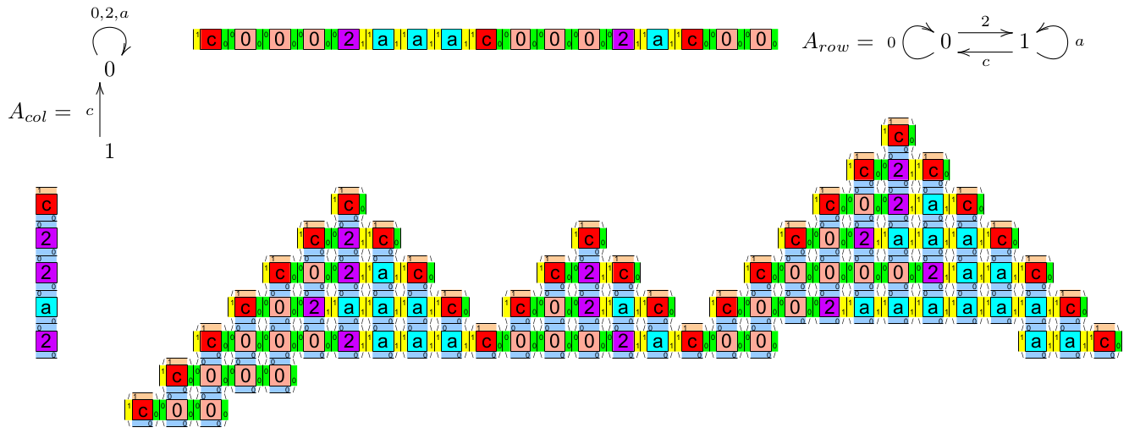
LPP - example
The Dutch roof language:
Lrow = a*c(2a*c+0)* and Lcol = c(0+2+a)*

Slide 9
2-dimensional words & scenarios
Words
Scenarios

Slide 10
SATS, scenarios, accepted words
SATS (self-assembling tile system)
set of tiles + specification of labels for external borders
Example
Accepted scenarios/words:

Slide 11
Classical regular 2-dim expressions 2RE (a classical approach based on rectangular words)

Slide 12
2-dim regular expressions – 2RE (classic, rectangular words)
Simple 2-dim regular expressions
additive operators: +, 0
vertical composition operators: I, ;, *
horizontal composition operators: -, >, ^
2RE – add:
intersection: /\
renaming: rho:V->V’
(V,V’ – the old and new vocabulary)
Example: (b*; a; c*)^ /\ (c^ > a > b^)*

Slide 13
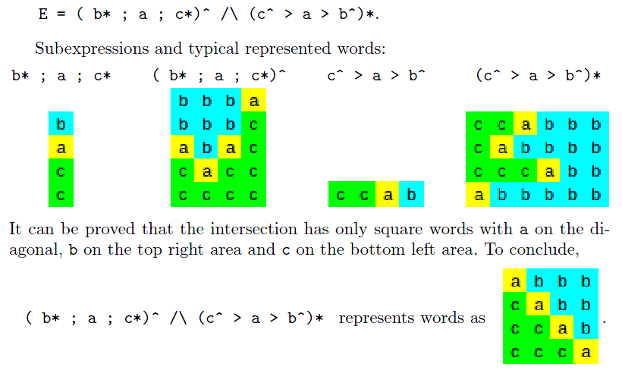
Example

Slide 14
Connecting 2RE's to SATS's
Theorem:
The languages of rectangular words represented by
SATS (self-assembling tile systems)
and those specified by
classical 2-dimensional regular expressions 2RE
are
the same.

Slide 15
Problems
Intersection is a nonintuitive operator:
difficult to grasp what you get by intersecting of 2 or more languages
The formalism is not robust under renaming:
E3 = ( a* ; a ; a*)^ /\ (a^ > a > a^)*, does not generates square of a’s,
but E1 = ( b* ; a ; c*)^ /\ (c^ > a > b^)* does generate
Renaming is yet a still more nonintuitive operator:
it's like writing in Chinese and getting an English text using a letter-to-letter renaming

Slide 16
Arbitrary shape words

Slide 17
Scenario composition
Given scenarios:
Composed scenarios:

Slide 18
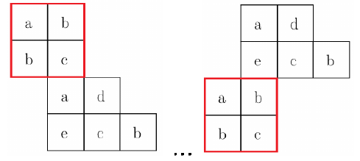
Word vs. scenario composition
Border agnostic word composition
vs. scenario
composition
13 cases

Slide 19
Gluing constraints
How to get only those 3 compositions?
General composition

Slide 20
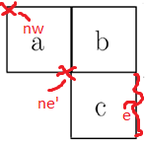
Constraints on words borders
Elements of interest:
side border (e,…)
land corner (nw,…)
golf corner (ne’,…)
Constrain formulas:
= - equal (e=w)
< - included in (e<w)
# - overlap (e#w)

Slide 21
Examples – restricted compositions
3 composed words
… obtained with restricted compositions
for (a): v (w=e) w
for (b): v (sw'=sw) w
for (c): v (ne>nw) w

Slide 22
Regular expressions – n2RE
Basic class: n2RE
Use composition and itereated composition corresponding to the following restrictions:
Elements on contours: side borders, land corners, and golf corners;
Comparison relations: equal-to (=), included-in (<), overlap-with (#)
General formulas: boolean formulas built on top of these atomic formulas
Extended: x2RE
Use extreme cells (= cells with no more than 1 neighbour in the word)

Slide 23
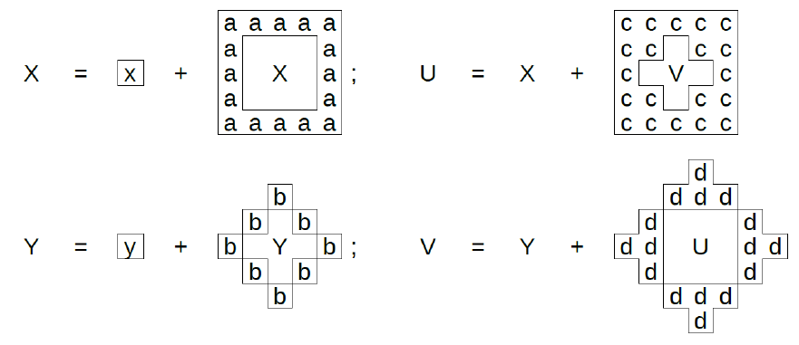
Recursive definitions
Definition
Example

Slide 24
A particular case: SATS with 2-colors for borders

Slide 25
2x2 SATS
2-color border tiles
Subsets: e.g., F02ac
External w/n/e/s borders: e.g., 1100=c
General representation of a 2x2 SATS:
F02ac.c

Slide 26
A case study: the Dutch roof language
F02ac.c
Transitions
External borders:
w=1, n=1, e=0, s=0

Slide 27
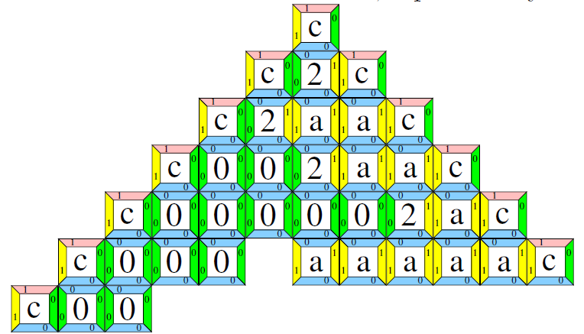
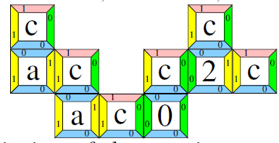
hv-connected components
Basic form
- “hat”
General form (hats connected via right-left legs)

Slide 28
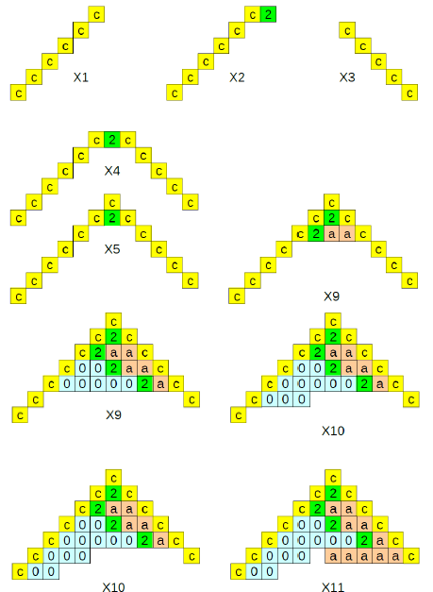
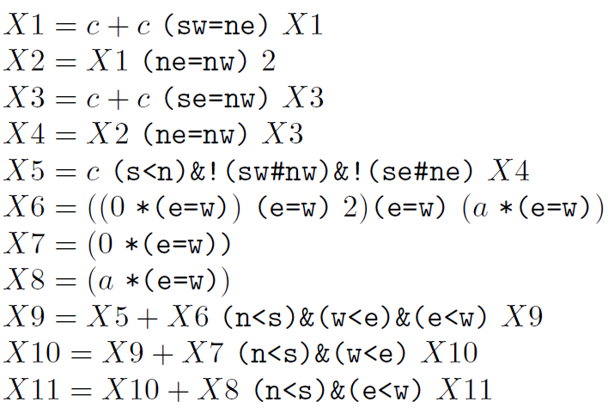
Recursive specification: basic form
Recursive system

Slide 29
A research programme:
From SATS to 2RE:

Slide 30
Distributed Programs

Slide 31
A slogan
Distributed programs
= (control & interaction)
+ (temporal & spatial) data
Moreover:
control & interaction => modeled by SATS

Slide 32
A glimpse on AGAPIA programming
Agapia: a programming language based on recatangular 2-dim words/scenarios
2 versions: v0.1 (basic) and v0.2 (supporting recursive computation)
Towards the v1 release (current partial developments):
adding spatial and temporal pointers
integrating object-oriented concepts
A compiler with MPI and OpenMP targets
C Parudaru's PhD Thesis

Slide 33
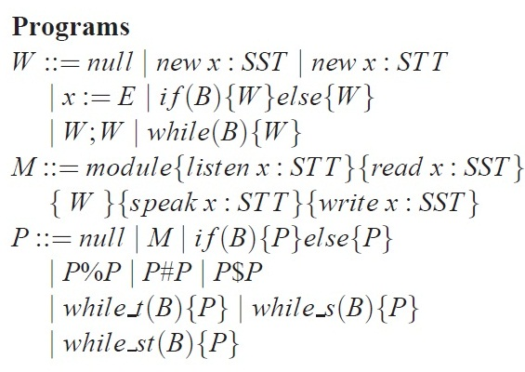
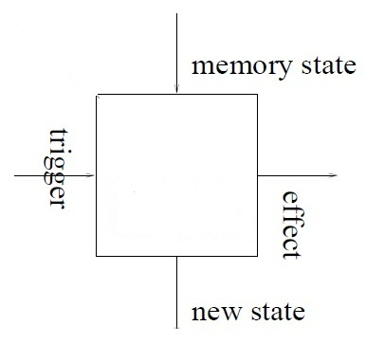
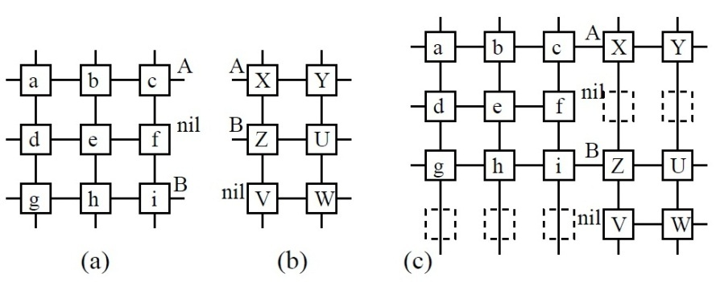
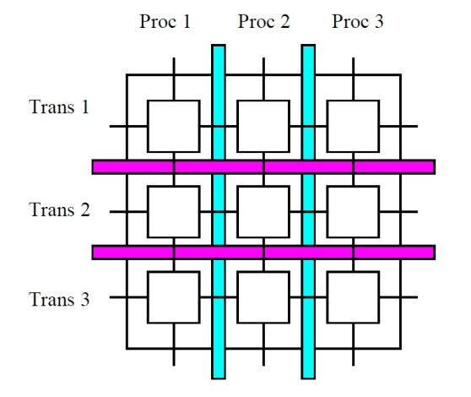
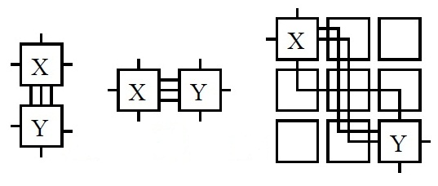
Code
W
Composition:
33

Slide 34
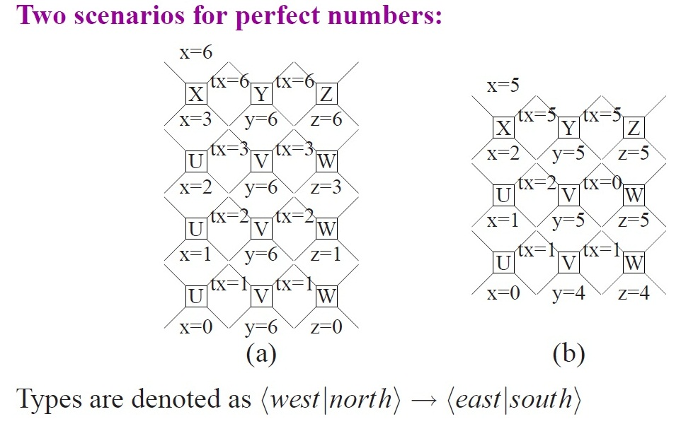
Notes:
34

Slide 35
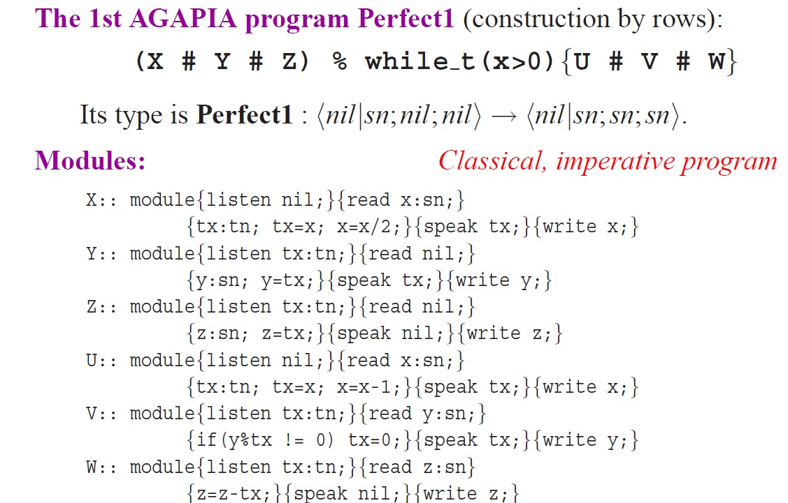

Slide 36
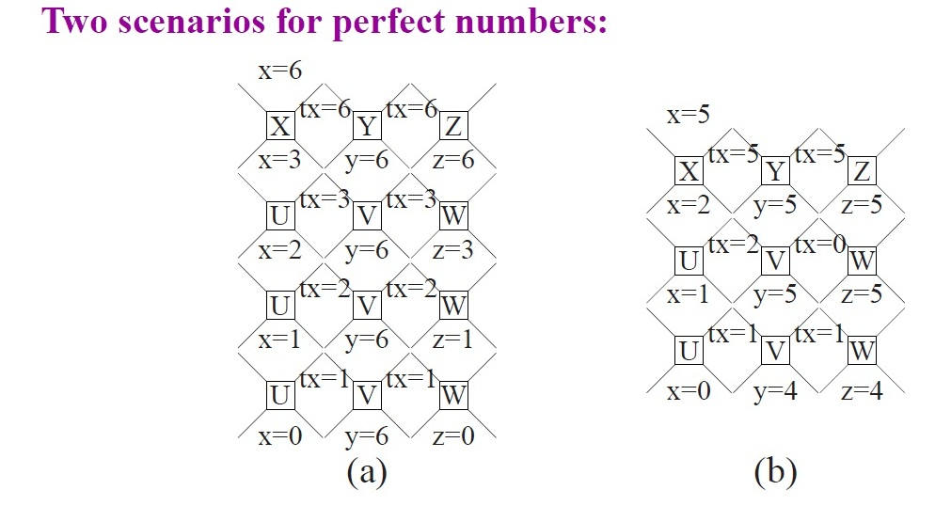
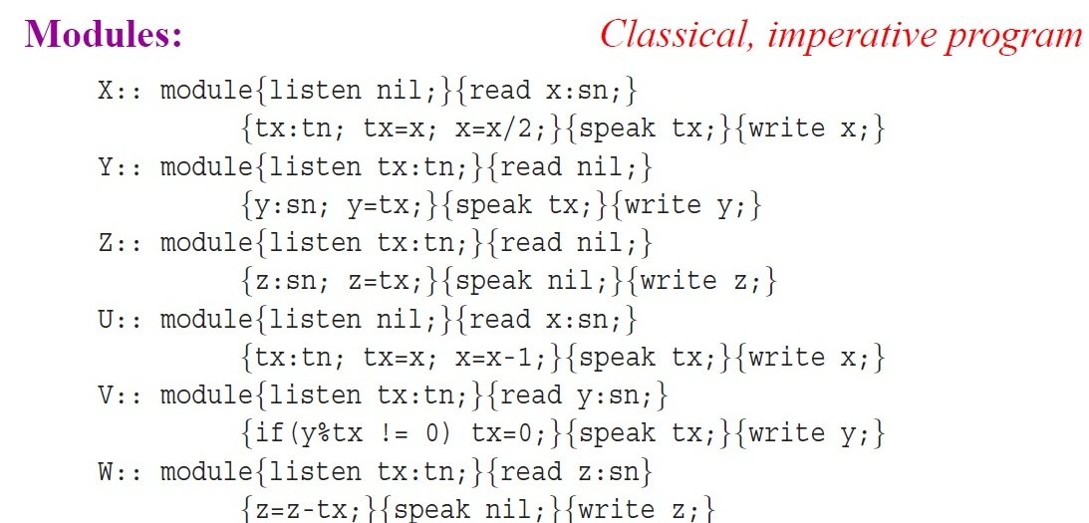

Slide 37
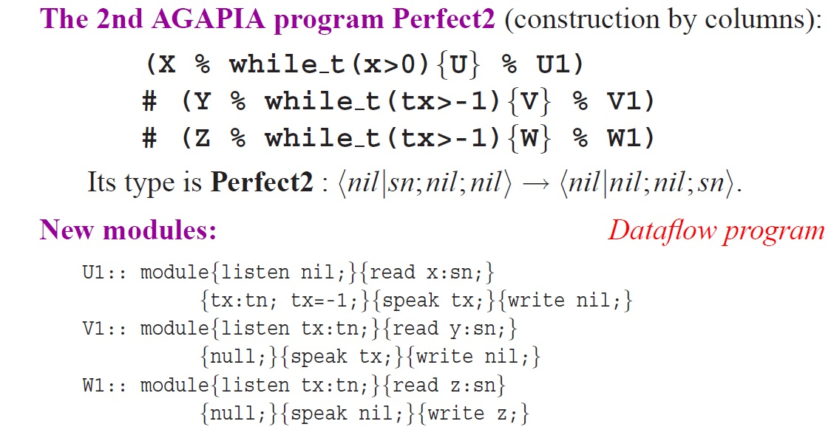

Slide 38
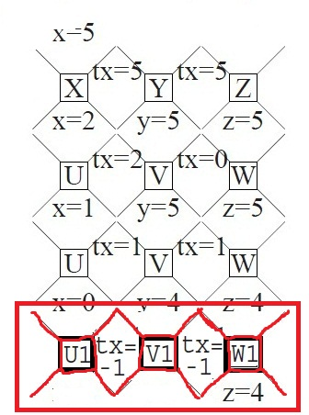

Slide 39
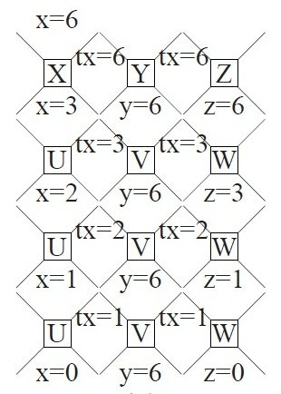
Free combination of imperative/dataflow models

Slide 40
Applications (a few samples)

Slide 41
Applications
A few samples:
From strings to images: lift problems, algorithms, and packages from 1 to 2 dimensions
Verification of interactive, parallel, distributed programs using spatial-temporal logics
New data types – generalized arrays – for dealing with arbitrary shape words
Space-time resource management – e.g., job scheduling using synchronizations via temporal pointers

Slide 42
Thank you !

