Slide 1
Text categorization using hyper rectangular keyword extraction: Application to news articles classification
Abdelaali Hassaine, Souad Mecheter and Ali Jaoua
Qatar University
RAMICS2015- Braga
30-9-2015

Slide 2
Outline
Existing methods
Definitions
Keyword extraction
Classification
Results
Conclusion and future work

Slide 3
Projects
Financial Watch
Mining Islamic web
Improving interfaces by mining the deep web (hidden data)

Slide 4
Introduction
Natural language is as difficult as human thinking understanding.
Is there any shared method (between different natural languages) for extracting the most relevant words or concepts in a text ?
What is the meaning of understanding a text?
Isn’t it first a summarization process consisting in assigning names to concepts used to link in an optimized way different elements of a text?
How could we apply these ideas to extract names as labels of significant concepts in a text in order to characterize a document? What we call conceptual features.
How could we feed known classifiers by these features in order to have better accuracy while classifying a document?
We should conciliate between a “good feature” and “feature extraction”.

Slide 5
Existing methods
Text categorization techniques have two steps:
keyword extraction (in which relevant keywords are selected)
Classification (in which features are combined to predict the category of documents)
Existing methods usually focus on one of those steps.
Developed methods are usually adapted for specific databases.
Our method focuses on the first step, it extracts keywords in a hierarchical ordering of importance.
Corpus of documents
1. Keyword extraction/feature selection
2. Classification
Category of document

Slide 6
Features and Classifiers
Classifiers for categorical prediction:weka.classifiers.IBk: k-nearest neighbour learner
weka.classifiers.j48.J48: C4.5 decision trees
weka.classifiers.j48.PART: rule learner
weka.classifiers.NaiveBayes: naive Bayes with/without kernels
weka.classifiers.OneR: Holte's OneR
weka.classifiers.KernelDensity: kernel density classifier
weka.classifiers.SMO: support vector machines
weka.classifiers.Logistic: logistic regression
weka.classifiers.AdaBoostM1: AdaBoost
weka.classifiers.LogitBoost: logit boost
weka.classifiers.DecisionStump: decision stumps (for boosting)

Slide 7
Outline
Existing methods
Definitions
Keyword extraction
Classification
Results
Conclusion and future work

Slide 8
Definitions
Formal context
A triplet $K=\left(X,Y,ℛ\right)$, where:
$X$ is a set of objects.
$Y$ is a set of attributes
$ℛ$ is a binary relation, a subset of the Cartesian product $X×Y$. Each couple $(x,a)∈ℛ$ expresses that the object $x∈X$ has the attribute $a∈Y$.
The image of $x$ by relation $ℛ$
$x. ℛ=\{a∈Y|(x,a)∈ℛ$}
The image of set X by relation $ℛ$
$X. ℛ=\bigcup_{x∈X}{\{a∈Y|(x,a)∈ℛ\text{\}}}$
The relative product of two relations $ℛ$ and $ℛ′$
$ℛ∘ℛ^{′}=\left\{\left(e,e^{′}\right)\left|∃t\right|\left(\left(e,t\right)∈ℛ\right)and \left(\left(t,e^{′}\right)∈ℛ^{′}\right)\right\}$
The converse of the relation $ℛ$
$ℛ^{−1}=\{(e,e′)|(e^{′},e)∈ℛ\}$

Slide 9
Definitions
The Identity relation
$ℐ(A)$ is a binary relation on set $A$ such that $∀a∈A,a.ℐ\left(A\right)=\{a\}$
The cardinality of $ℛ$
$Card\left(ℛ\right)=number of pairs (e,e′)∈ℛ$
Rectangles
Let $ℛ$ be a binary relation between $X$ and $Y$
A rectangle of $ℛ$ is a Cartesian product of two non empty sets $A⊆X$ and $B⊆Y$ and $A×B⊆ℛ$
The rectangular closure of $ℛ$ is $ℛ^{∗}=X⋅ℛ×ℛ⋅Y$
A rectangle $A×B⊆ℛ$ is called non-enlargeable if: $A×B⊆A^{′}×B^{′}⊆ℛ⇒\left(A=A^{′}\right)∧(B=B′)$. In terms of formal concept analysis, a non enlargeable rectangle is called a formal concept.
Formal concept
Let $K=\left(X,Y,ℛ\right)$ be a formal context. If A and B are non empty sets, such that $A⊆X$ and $B⊆Y$. The pair $(A,B)$ is a formal concept if and only if $A×B$ is a non enlargeable rectangle.

Slide 10
Rectangle labeling: Economy of Information and Information abstraction
3

Slide 11
Pseudo-rectangle
(PSEUDO-RECTANGLE) The pseudo-rectangle containing the couple (a, b) is the union of all the Non Enlargeable Rectangles containing (a, b).
PR(a,b)= I (b.R−1 ) $∘$R $∘$I (a.R)

Slide 12
State of Art
3.1. Belkhiter et al.’s Approach
The approach of Belkhiter et al. aims at finding an optimal cover of a binary relation, by first listing all pseudo-rectangles and start by the most promising one (i.e. the one containing the most dense rectangle with highest number of elements) using a Branch and Bound Approach.
Used metric:
score(PR(a,b))= (|PR|/|(|b.R⁻¹| x |a.R|)) x
(|PR| - (b.R⁻¹+ a.R))

Slide 13
Pseudo-Rectangle
 | a | b | c | d | e | f
1 | × | × | × |  | ×
2 | × | ×
3 | × |  | × | × | ×
4 |  |  | × | ×
5 |  |  |  |  | × | ×
6 |  |  |  |  | × | ×
 | a | b | c | e
1 | × | × | × | ×
2 | × | ×
3 | × |  | × | ×
Pseudo-rectangle associated to pair (1,a)
d=3; c=4; r =9;
Score (PR(1,a)= (9/12) x ( 9-7)=0.5.

Slide 14
Strength of a pair (document, word)
b
a
d = 4; c=5; r=10; Score(a,b) = (10/20)x(10-9)=0.5

Slide 15
Feature extraction in decreasing importance order
After sorting of the different pairs of R in increasing order in terms of their calculated strength, and removing word redundancy, we obtain the following heap of words: (11), (9), (7), (8), (10), (12).
Which means that the most pertinent word is 11, then 9, 7, 8, 10 and 12, in decreasing importance order.

Slide 16
Kcherif et al: Fringe Relation
Approach of Kcherif et al. (2000)
Starting from the fringe relation associated to R:
_____________
___
Rd = R ◦ R−1 ◦ R ∩ R (Riguet 1995)
We start searching first isolated Rectangles.
Pb: Some many relation Rd is empty.
Later a solution: Creation of composed attributes. (INS 2014): Ferjani et al. INS 2013.

Slide 17
Approach of Belohlavek and Vychodil (2010)
They proposed a new method of
Decomposition of an n × m binary matrix I into a Boolean product A o B of an n × k binary matrix A and a k × m binary matrix B with k as small as possible. In their approach [2], they proved an optimality theorem saying that the decompositions with the least number k of factors are those where the factors are formal concepts.
Theorem 6. [2]
Let R = A ◦ B for n × k and k × m binary matrices A and B. Then there exists a set F ⊆ B(X, Y, I ) of formal concepts of R with |F |≤ k such that for the n× | F | and |F | ×m binary matrices AF and BF we have R = AF ◦ BF
Similar theorem in Relational Calculus may be found:
Case of difunctional relation: R= f ◦ g⁻¹ where f and g are functions. Here k is the cardinal of the range of f.
This is generalizable to any relation : R= A ◦ B⁻¹ , where A is the classification of elements of the domain of R with respect to some number of basic « Maximal rectangles » convering R , and B is the classification of elements of the Co-domain of R with respect to the same basic set.
Heuristics used by Belohlavek based on concepts which are simultanesly object and attribute concepts is very similar to the method published in 2000 in INS journal using fringe relations. As each element of the fringe relation may be considered as an object and attribute concept.

Slide 18
Some Publications
[j24] Fethi Ferjani, Samir Elloumi, Ali Jaoua, Sadok Ben Yahia, Sahar Ahmad Ismail, Sheikha Ravan: Formal context coverage based on isolated labels: An efficient solution for text feature extraction. Inf. Sci. 188: 198-214 (2012)
[c27] Sahar Ahmad Ismail, Ali Jaoua: Incremental Pseudo Rectangular Organization of Information Relative to a Domain. RAMICS 2012: 264-277
[c26] Masoud Udi Mwinyi, Sahar Ahmad Ismail, Jihad M. Alja'am, Ali Jaoua: Understanding Simple Stories through Concepts Extraction and Multimedia Elements. NDT (1) 2012: 23-32
[j15] Raoudha Khchérif, Mohamed Mohsen Gammoudi, Ali Jaoua: Using difunctional relations in information organization. Inf. Sci. 125(1-4): 153-166 (2000)
Pseudo-conceptual text and web structuring, Ali Jaoua, Proceedings of The Third Conceptual Structures Tool Interoperability Workshop (CS-TIW2008). CEUR Workshop Proceedings
Volume, 352,Pages, 22-32

Slide 19
Definitions
Hyper Rectangle ( also called hyper concept)
Let $K=\left(X,Y,ℛ\right)$ be a formal context and $a∈Y$ an attribute. Let $v$ be a vector such that $v=a⋅ℛ^{−1}×S$, where $S$ is the universal set. The hyper rectangle denoted by $H_{a}(ℛ)$ is a sub relation of $ℛ$ such that $H_{a}\left(ℛ\right)=ℛ∩(v∘L)$, where $L$ is the universal relation $L=S×S.$
$H_{a}\left(ℛ\right)$ may also be expressed as $H_{a}\left(ℛ\right)=ℐ\left(a⋅ℛ^{−1}\right)∘ℛ.$
The hyper rectangle associated to an element $a$ is the union of all non enlargeable rectangles containing $a$.
In formal concept analysis, a non-enlargeable rectangle is also called a concept. Therefore a hyper rectangle is also called hyper concept.

Slide 20
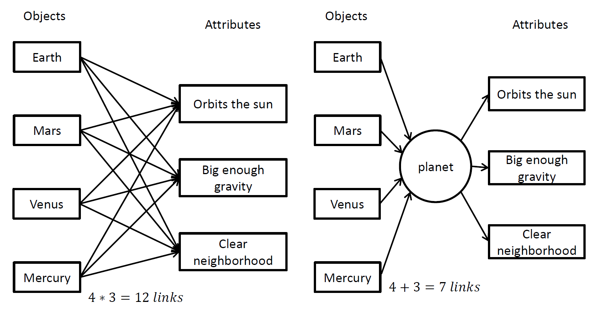
Definitions
Weight of hyper rectangle
The weight of $H_{a}\left(ℛ\right)$ is ${W(H}_{a}\left(ℛ\right))=\frac{r}{d∗c}∗\left(r−\left(d+c\right)\right)$, where $r$ is the cardinality of $H_{a}\left(ℛ\right)$ (i.e. the number of pairs in the binary relation $H_{a}\left(ℛ\right)$), $d$ is the cardinality of its domain, and $c$ is the cardinality of its codomain.
Without considering the concept
After considering the concept

Slide 21
Definitions
Optimal hyper rectangle
$maxH_{a}(ℛ)$ is the hyper rectangle which has the maximum weight, that is $W\left(H_{a}\left(ℛ\right)\right)≥W\left(H_{b}\left(ℛ\right)\right)∀b≠a,b∈Cod(ℛ)$.
Remaining relation
The Remaining Binary Relation is the relation $ℛ$ minus the optimal Hyper Rectangle: $ℛ_{m}\left(ℛ\right)=ℛ−maxH_{a}(ℛ)$ . The remaining relation is useful for splitting a relation into a hierarchy of hyper rectangles.

Slide 22
Outline
Existing methods
Definitions
Keyword extraction
Classification
Results
Conclusion and future work

Slide 23
New Keyword extraction Based on Hyper-rectangles
Hyper concept method
A corpus is represented as a binary relation
Co-domain
 | Word₁ | Word₂ | … | Word₃
Document₁ | 1 | 1 | … | 0
Document₂ | 0 | 1 | … | 1
… | … | … | … | …
Document_{M} | 0 | 1 | … | 0
Domain

Slide 24
Keyword extraction
 | word₁ | word₂ | word₃ | word₄
Doc₁ | 1 | 1 | 0 | 0
Doc₂ | 1 | 0 | 1 | 1
Doc₃ | 1 | 1 | 1 | 0
Doc₄ | 0 | 1 | 1 | 1

Slide 25
Keyword extraction
 | word₁ | word₂ | word₃ | word₄
Doc₁ | 1 | 1 | 0 | 0
Doc₂ | 1 | 0 | 1 | 1
Doc₃ | 1 | 1 | 1 | 0
Doc₄ | 0 | 1 | 1 | 1

Slide 26
Keyword extraction
 | word₁ | word₂ | word₃ | word₄
Doc₁ | 1 | 1 | 0 | 0
Doc₂ | 1 | 0 | 1 | 1
Doc₃ | 1 | 1 | 1 | 0
Doc₄ | 0 | 1 | 1 | 1

Slide 27
Keyword extraction
 | word₁ | word₂ | word₃ | word₄
Doc₁ | 1 | 1 | 0 | 0
Doc₂ | 1 | 0 | 1 | 1
Doc₃ | 1 | 1 | 1 | 0
Doc₄ | 0 | 1 | 1 | 1
 | word₁ | word₂ | word₃ | word₄
Doc₁ | 1 | 1 | 0 | 0
Doc₂ | 1 | 0 | 1 | 1
Doc₃ | 1 | 1 | 1 | 0
r=card(Relation)=8
d=3
c=4

Slide 28
Keyword extraction
 | word₁ | word₂ | word₃ | word₄
Doc₁ | 1 | 1 | 0 | 0
Doc₂ | 1 | 0 | 1 | 1
Doc₃ | 1 | 1 | 1 | 0
Doc₄ | 0 | 1 | 1 | 1
 | word₁ | word₂ | word₃ | word₄
Doc₁ | 1 | 1 | 0 | 0
Doc₂ | 1 | 0 | 1 | 1
Doc₃ | 1 | 1 | 1 | 0
Associated weight:
$$W\left(H\left(R\right)\right)=\frac{r}{d∗c}∗(r−\left(d+c\right))$$
Where
c=card(domain)
d=card(codomain)
r=card(relation)
$$W\left(H\left(R\right)\right)=\frac{8}{3∗4}∗\left(8−\left(3+4\right)\right)$$
$$=\text{0.}\text{666}$$

Slide 29
Keyword extraction
 | word₁ | word₂ | word₃ | word₄
Doc₁ | 1 | 1 | 0 | 0
Doc₂ | 1 | 0 | 1 | 1
Doc₃ | 1 | 1 | 1 | 0
Doc₄ | 0 | 1 | 1 | 1

Slide 30
Keyword extraction
 | word₁ | word₂ | word₃ | word₄
Doc₁ | 1 | 1 | 0 | 0
Doc₂ | 1 | 0 | 1 | 1
Doc₃ | 1 | 1 | 1 | 0
Doc₄ | 0 | 1 | 1 | 1
 | word₁ | word₂ | word₃ | word₄
Doc₁ | 1 | 1 | 0 | 0
Doc₃ | 1 | 1 | 1 | 0
Doc₄ | 0 | 1 | 1 | 1
Associated weight:
$$W\left(H\left(R\right)\right)=\frac{r}{d∗c}∗(r−\left(d+c\right))$$
Where
c=card(domain)
d=card(codomain)
r=card(relation)
$$W\left(H\left(R\right)\right)=\frac{8}{3∗4}∗\left(8−\left(3+4\right)\right)$$
$$=\text{0.}\text{666}$$

Slide 31
Keyword extraction
 | word₁ | word₂ | word₃ | word₄
Doc₁ | 1 | 1 | 0 | 0
Doc₂ | 1 | 0 | 1 | 1
Doc₃ | 1 | 1 | 1 | 0
Doc₄ | 0 | 1 | 1 | 1

Slide 32
Keyword extraction
 | word₁ | word₂ | word₃ | word₄
Doc₁ | 1 | 1 | 0 | 0
Doc₂ | 1 | 0 | 1 | 1
Doc₃ | 1 | 1 | 1 | 0
Doc₄ | 0 | 1 | 1 | 1
 | word₁ | word₂ | word₃ | word₄
Doc₂ | 1 | 0 | 1 | 1
Doc₃ | 1 | 1 | 1 | 0
Doc₄ | 0 | 1 | 1 | 1
Associated weight:
$$W\left(H\left(R\right)\right)=\frac{r}{d∗c}∗(r−\left(d+c\right))$$
Where
c=card(domain)
d=card(codomain)
r=card(relation)
$$W\left(H\left(R\right)\right)=\frac{9}{3∗4}∗\left(9−\left(3+4\right)\right)$$
$$=\text{1.5}$$

Slide 33
Keyword extraction
 | word₁ | word₂ | word₃ | word₄
Doc₁ | 1 | 1 | 0 | 0
Doc₂ | 1 | 0 | 1 | 1
Doc₃ | 1 | 1 | 1 | 0
Doc₄ | 0 | 1 | 1 | 1

Slide 34
Keyword extraction
 | word₁ | word₂ | word₃ | word₄
Doc₁ | 1 | 1 | 0 | 0
Doc₂ | 1 | 0 | 1 | 1
Doc₃ | 1 | 1 | 1 | 0
Doc₄ | 0 | 1 | 1 | 1
 | word₁ | word₂ | word₃ | word₄
Doc₂ | 1 | 0 | 1 | 1
Doc₄ | 0 | 1 | 1 | 1
Associated weight:
$$W\left(H\left(R\right)\right)=\frac{r}{d∗c}∗(r−\left(d+c\right))$$
Where
c=card(domain)
d=card(codomain)
r=card(relation)
$$W\left(H\left(R\right)\right)=\frac{6}{2∗4}∗\left(6−\left(2+4\right)\right)$$
$$=\text{0}$$

Slide 35
Keyword extraction
 | word₁ | word₂ | word₃ | word₄
Doc₁ | 1 | 1 | 0 | 0
Doc₂ | 1 | 0 | 1 | 1
Doc₃ | 1 | 1 | 1 | 0
Doc₄ | 0 | 1 | 1 | 1
 | word₁ | word₂ | word₃ | word₄
Doc₂ | 1 | 0 | 1 | 1
Doc₃ | 1 | 1 | 1 | 0
Doc₄ | 0 | 1 | 1 | 1
 | word₁ | word₂
Doc₁ | 1 | 1
Remaining relation
Hyper concept

Slide 36
Keyword extraction
By applying this rectangular decomposition in a recursive way, a browsing tree of the corpus is constructed.
This hyper concepts tree makes it possible to represent a big corpus in a convenient structured way.

Slide 37
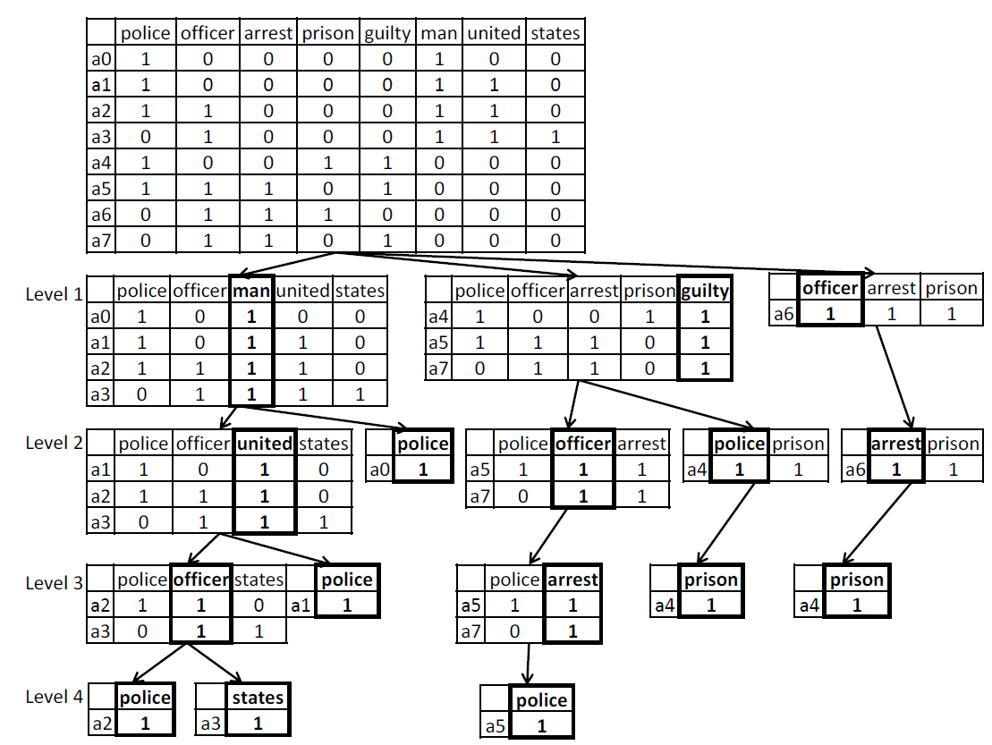
Keyword extraction
Hyper rectangles tree of a small set of documents

Slide 38
Outline
Existing methods
Definitions
Keyword extraction
Classification
Results
Conclusion and future work

Slide 39
Classification
For a given depth $d$ of the hyper rectangle tree, and for each category $i$ of documents, a set of keywords $S_{d}\left(i\right)$ is obtained.
Those keywords are fed into a random forest classifier.
Random forest is an ensemble of several decision trees.

Slide 40
Outline
Existing methods
Definitions
Keyword extraction
Classification
Results
Conclusion and future work

Slide 41
Results
We used the Reuters-21578 dataset.
Contains 7674 news articles, out of which 5485 are used for training and 2189 for testing.
Articles are categorized into 8 different news categories.

Slide 42
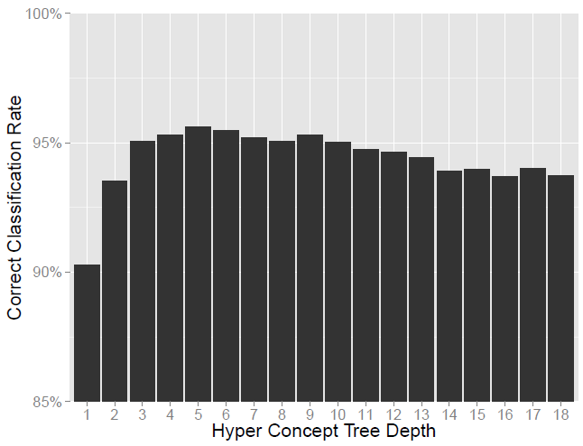
Results
Classification results for increasing hyper rectangles tree depth.

Slide 43
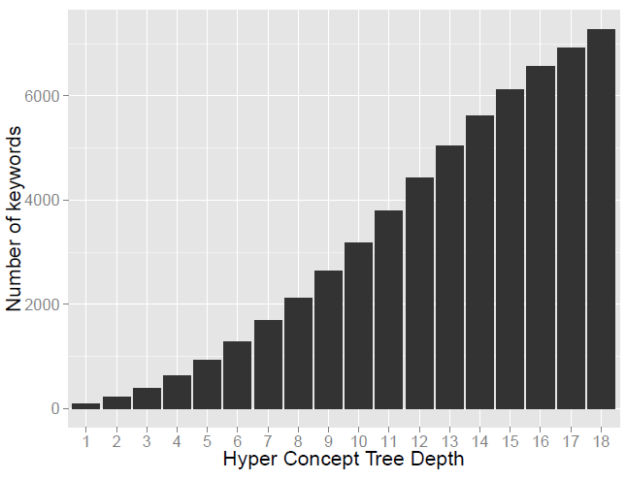
Results
Number of keywords per hyper rectangles tree depth.

Slide 44
Results
Method | Accuracy
Our Method | 95.61 %
Yoshikawa et al. | 94 %
Jia et al. | 96.12 %
Kurian et al. | 92.37 %
Cardoso-Cachopo et al. | 96.98 %
Lee et al. | 94.97 %
Comparison with state-of-the-art methods

Slide 45
Outline
Existing methods
Definitions
Keyword extraction
Classification
Results
Conclusion and future work

Slide 46
Conclusion and future work
New method for keyword extraction using the hyper rectangular method.
When fed to a classifier, the keywords lead to high document categorization accuracy.
Future work include:
Trying new ways for computing the weight of the hyper rectangle such as entropy based metrics.
Validation on other databases is to be considered as well.
Other classifiers to be tested and combined.

Slide 47
Utilization of Hyper-rectangles for minimal rectangular coverage
Hyper-rectangles induced a rectangular coverage of a binary relations.
It should be compared to other methods.
An extension of hyper-rectangular coverage to both the elements of the domain and the range of a relation (in the case of bipartite ones) should improve the abstraction of a relation and therefore to the corpus behind it.
Ha(R), and Hd(R) should be compared at the same level. This should give better optimized structures.
we should recalculate the weight of remaining elements in the range and domain with respect to the initial relation.

Slide 48
THANK YOU !!!
“This paper was made possible by [NPRP 6-1220-1-233 ] from the Qatar National Research Fund (a member of Qatar Foundation). The statements made herein are solely the responsibility of the author[s].”

