Slide 1
Loop Analysis and Repair
Nafi Diallo
Computer Science
NJIT
Advisor: Dr. Ali Mili

Slide 2
Outline
1. Introduction
2. Progress
3. Prospects
4. Conclusion
Introduction
Research Progress
Proposed work
Conclusion

Slide 3
Loop Analysis and Repair
1. Introduction
2. Progress
3. Prospects
4. Conclusion
Loop Analysis
Convergence
Termination + Absence of Abort
Correctness/Incorrectness
Loop Repair
Diagnose/Remove Faults
Verification

Slide 4
Definition
1. Introduction
2. Progress
3. Prospects
4. Conclusion
We consider a while loop w of the form :
$$w:while\left(t\right)\left\{b\right\}$$
$S$ denotes the state space of $w$ and $s∈S$
$[b]or B$represent the function of the loop:
$$B=\{(s.s′)|if b starts execution in s,$$
$$then it terminates normally in s′\}$$

Slide 5
Definition
1. Introduction
2. Progress
3. Prospects
4. Conclusion
T is the relational vector defined by:
$$T=\{(s.s′)│t(s) \}$$
The loop semantics is defined by means of the reflexive transitive closure of 𝑇∩𝐵:
$$[w:while(t)\{b\}]={\left(T∩B\right)}^{∗}∩\hat{\overline{T}}$$

Slide 6
Invariant Relation
1. Introduction
2. Progress
3. Prospects
4. Conclusion
Interpretation:
pairs of states (s,s') that are separated by an arbitrary number of iterations
Example:
𝐰𝐡𝐢𝐥𝐞(𝐤! = 𝐧){𝐤 = 𝐤 + 𝟏; 𝐟 = 𝐟∗ 𝐤;}
An invariant relation is : $\left\{\left(s,s^{′}\right) | \frac{f}{k!}=\frac{f^{′}}{k^{′}!}\right\}$
Notes:
An Invariant assertion is : 𝑓=𝑘!
Also dependent on the context of the loop

Slide 7
Invariant Relations and Invariant Assertions
1. Introduction
2. Progress
3. Prospects
4. Conclusion
All invariant assertions stem from invariant relations
Only a subset of invariant relations can be derived from invariant assertions
R is an invariant relation
ν is a vector
A is an invariant assertion
Invariant Relation
Inductive Invariant Relation
Invariant Assertion
Invariant Assertion
Notes:
mention: the formula A = \widehat{R}\circ v is interesting because it highlights the structure of invariant assertions by separating the part that depends on the loop (R) from the part that depends on its context (v: precondition).
also: if all we focus the search of invariant assertions on the search for invariant relations, then we can be sure that we do not miss any invariant assertions, due to result 1.

Slide 8
Convergence:
Integrating Abort freedom with Termination
1. Introduction
2. Progress
3. Prospects
4. Conclusion
A general framework for Convergence
Theorem 1
We consider a while loop w of the form $w: while (t) \{b\}$on space S, and we let R be an invariant relation for w. Then: $WL⊆R\overline{T}$
Capturing aspects of abort freedom
Theorem 2
We consider a while loop w of the form w: while (t) {b} on space $S$, and we let B′ be a superset of $(T∩B).$If B′ satisfies the following conditions:
$B^{′+}∩I=∅$
The following relation $\overline{Q=B^{′∗}(B^{′+}∩V )}$is transitive, for an arbitrary vector V .
$T ∩ B ∩ B^{′+}B′ = ∅.$ ( condition of concordance)
then $R =\overline{\left({B^{′}}^{∗}\left({B^{′}}^{+} ∩\overline{BL}\right)\right)}$is an invariant relation for w.
Notes:
Interpretation
An invariant relation= a necessary condition of termination
A necessary and sufficient condition possible
With enough invariant relations
Termination aspect is irrelevant
Only needs to be evidenced by the invariant relation

Slide 9
Abort-Freedom Invariant Relations
1. Introduction
2. Progress
3. Prospects
4. Conclusion
Logical form of Theorem 2
$$R=\left\{\left(s,s^{′}\right) | ∀u:\left(s,u\right)∈B^{′∗}∧\left(u,s^{′}\right)∈B^{′+}⇒u∈dom\left(B\right)\right\}$$
Applications:
Array out of bounds
Illegal arithmetic operations
Arithmetic overflow
Illegal Pointer reference
Notes:
We use dom(B) to record the abort conditions we want to model

Slide 10
Termination: Example
1. Introduction
2. Progress
3. Prospects
4. Conclusion
$$\text{while}\text{ (}\text{i}\text{!=0) \{}\text{i}\text{=}\text{i}\text{+2; }\text{x}\text{=}\text{x}\text{−5; }\text{y}\text{=}\text{y}\text{−}\text{y}\text{/}\text{x}\text{;\}}$$
Abort condition: Illegal arithmetic operation
$R=\left\{\left(s,s^{′}\right) | ∀u:\left(s,u\right)∈B^{′∗}∧\left(u,s^{′}\right)∈B^{′+}⇒u∈def\left(f\right)\right\}$
$f\left(x\right)=\frac{1}{x}$
$B^{′}=\{\left(s,s^{′} | x^{′}=x−5\right\} B^{′+}=\left\{\left(s,s^{′}\right) | x^{′}<x\right\} { B}^{′∗}=\{(s,s^{′})|x^{′}≤x\}$
$R_{1}=\left\{\left(s,s^{′}\right) | ∀h:x^{′}≤h<x, h−5≠0\right\}$
$R_{2}=\left\{\left(s,s^{′}\right) | i≤i^{′}\right\}$
$R_{3}=\left\{\left(s,s^{′}\right) | 5i+2x=5i^{′}+2x′\right\}$
Termination condition

Slide 11
Termination: Example
1. Introduction
2. Progress
3. Prospects
4. Conclusion
Notes:
these results are obtained by applying theorem 3 twice, using the result of the inner loop as dom(B) for the outer loop

Slide 12
Correctness/Incorrectness
1. Introduction
2. Progress
3. Prospects
4. Conclusion
A necessary condition of correctness
Proposition: Let w be a while loop of the form $while (t) \{b\}$ that terminates for all states in S. Let R be an invariant relation for w, and let V be a specification on S. If w is correct with respect to V then $\left(V∩R\right)\overline{T} = VL$.
Interpretation: Incorrect if the invariant relation is incompatible with the specification
A sufficient condition of correctness
Proposition: Given a while loop w of the form $while (t) \{b\}$that terminates for all states in its space $S$, and given a specification $U$ on $S$, if an invariant relation R of w satisfies the condition $R\overline{T}∩UL∩(U∪R∩\hat{\overline{T}})=U$
then w is correct with respect to U.
Interpretation: Correct only if the invariant relation subsumes the specification.

Slide 13
Algorithm for Verifying Loop Correctness
1. Introduction
2. Progress
3. Prospects
4. Conclusion
INPUT
Loop w, Space S, Specification spec
S = S and Termination(w) [CumR = L]
More-inv-relation(w)?
No
yes
R=get-inv-relation(w)
No
Necessary(R,spec) ?
yes
[CumR=CumR∩R] sufficient(CumR,spec) ?
No
yes
OUTPUT
Correct OR Incorrect OR Undecided
13

Slide 14
Relative Correctness
1. Introduction
2. Progress
3. Prospects
4. Conclusion
Definition 1
Given
a specification R and
a program P
$dom(R∩P)$defines the competence domain of P and denotes the set of states on which 𝑷 obeys 𝑹.
Definition 2
Given
a specification R and
two programs P and P’, deterministic
𝑷’ more-correct than 𝑷 with respect to 𝑹:
𝑷’ has a larger competence domain than 𝑷.
$dom(R∩P)⊆dom(R∩P′ ).$
Denoted: $P^{′}⊒_{R}P$

Slide 15
Relative Correctness
1. Introduction
2. Progress
3. Prospects
4. Conclusion
$$dom\left(R∩P\right)=\left\{1,2,3,4\right\}×L$$
$$dom\left(R∩P′\right)=\left\{1,2,3,4,5\right\}×L$$
Therefore $P^{′}⊒_{R}P$
Notes:
Note that in order for program p ′ to be more-correct than program p, it does not have to duplicate the behavior of p over the competence domain of p: It may have a different behavior (since R is potentially non-deterministic) provided this behavior is also correct with respect to R
mention here: correctness enhancement without duplication: being more-correct does not mena duplicating correct behavior and behaving correctly elsewhere. it may mena behaving differently everywhere.

Slide 16
Impact of Relative Correctness on Testing
1. Introduction
2. Progress
3. Prospects
4. Conclusion
Impact on Test Data Generation:
$dom\left(R∩P\right)$ vs. $dom\left(R\right).$
Impact on Oracle Design:
$\left(s,s^{′}\right) ≡ \left(ω\left(s,P\left(s\right)\right) ⇒ω\left(s,s^{′}\right)\right).$
$$: oracle for absolute correctness.
$$: oracle for relative correctness.

Slide 17
Absolute Correctness and Relative Correctness
1. Introduction
2. Progress
3. Prospects
4. Conclusion
(Absolute) Correctness
$$dom\left(P∩R\right)=dom(R)$$
Culminates
Relative Correctness
$$dom(P∩R)⊆dom(P^{′}∩R)$$

Slide 18
A Formal Definition of fault
1. Introduction
2. Progress
3. Prospects
4. Conclusion
Definition 1
A feature in a program P is a statement, condition, formula, or combination thereof
Definition 2
Given
Specification $R$, Program $P$, feature $f$ in $P$:
A feature $f$ is said to be a fault in $P$ if and only if there exists a substitute $f’$ of $f$ that would make $P$ more-correct.
A pair of features $(f,f’)$is said to be a (monotonic) fault removal of $P$ if and only if program $P’$ obtained from $P$ by substituting $f’$ for $f$ is more-correct than $P$.

Slide 19
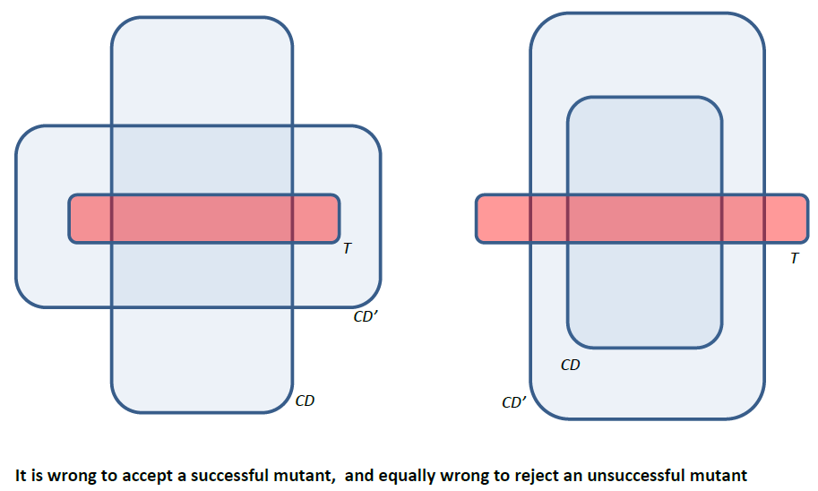
Loop Repair
1. Introduction
2. Progress
3. Prospects
4. Conclusion
Mutation Testing consists of :
Generating Mutants
Testing Mutants against some sample test data
Selecting mutants that pass
Rejecting mutants that fail
We argue
Selecting mutants that pass is wrong: a mutant may pass the test but still not be more-correct.
Rejecting mutants that fail is also wrong: a mutant may fail and still be more-correct.

Slide 20
Proving Relative Correctness
1. Introduction
2. Progress
3. Prospects
4. Conclusion
Traditionally:
static verification techniques applicable only to correct programs;
dynamic testing techniques used to expose/ diagnose faults in incorrect programs.
Using relative correctness:
We remove a fault from a program, check a set of conditions statically and locally, and conclude that the new program is more-correct than the old, all
Without testing (and its attending uncertainties),
Without remorse (final determination: no going back to question wisdom of fault removal).

Slide 21
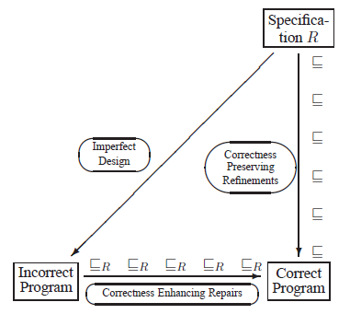
A Framework for Monotonic Fault Removal
1. Introduction
2. Progress
3. Prospects
4. Conclusion

Slide 22
Proving Relative Correctness
1. Introduction
2. Progress
3. Prospects
4. Conclusion
Theorem
Let R be a specification on space $S$ and let $w$ be a while loop of the form
$w:\{while \left(t\right)\left\{b\right\}\}$ which terminates for all $s∈S$.
Let $Q$ be an invariant relation of $w$ that is incompatible with $R$ and let $C$
be the largest invariant relation of $w$ such that $W=\left(C∩Q\right)∩\hat{\overline{T}}$
Let $w′$ be the while loop that has $C$ as an invariant relation , terminates
for all $s∈S$ and admits an invariant relation $Q′$ that is compatible with $R$
And satisfies the condition $W′=\left(C∩Q′\right)∩\hat{\overline{T}}$
Then $w′$ is strictly more correct that $w$

Slide 23
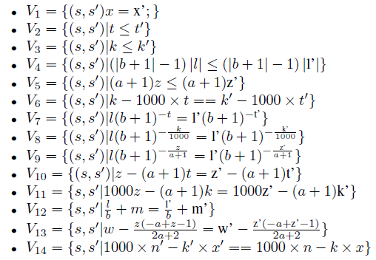
Illustration
1. Introduction
2. Progress
3. Prospects
4. Conclusion
Specification
Invariant Relations

Slide 24
Illustration
1. Introduction
2. Progress
3. Prospects
4. Conclusion
Pick $V_{9}$, thus consider $l and z$ to be involved in fault
Compute constraints
Working by elimination, we choose mutant 2.
Testing for absolute correctness fails but testing for relative correctness succeeds
We repeat the process and end up with one incompatible invariant relation $V_{12}$
Compute constraints and remove 2nd fault
Notes:
show the difference between testing for absolute correctness (loop fails)
and testing for relative correctness (loop succeeds).

Slide 25
Deployment
1. Introduction
2. Progress
3. Prospects
4. Conclusion
FxLoop Analyzer (C++ based)
Client-server application
Thin client
Server(HTTP) has 2 components
CCA compiler
Invariant relation generator using semantic matching
Databases of recognizers based on application domain
Computing termination condition
Traditional sense
In combination with Abort-freedom
Correctness verification

Slide 26
Analytical Research
1. Introduction
2. Progress
3. Prospects
4. Conclusion
To further explore the implications and applications of relative correctness,
To derive techniques for proving relative correctness by static analysis of the source code.
Notes:
I consider developments under 2 aspects:

Slide 27
Thank you!

